Slide 1

FY24 Budget Approval Meeting

Slide 2
Norms
This is a meeting of the GO Team. Only members of the team may participate in the discussion. Any members of the public present are here to quietly observe.
We will follow the agenda as noticed to the public and stay on task.
We invite and welcome contributions of every member and listen to each other.
We will respect all ideas and assume good intentions.

Slide 3
Agenda
Action Items (add items as needed)
  Approval of Agenda
  Approval of Previous Minutes
  Budget Approval (after final presentation/review and discussion)
Discussion Items (add items as needed)
  Presentation of the final budget
Information Items (add items as needed)
  Principal’s Report
    BASC-3 Results (if available)
    Spring ACES Presentation
Announcements

Slide 4

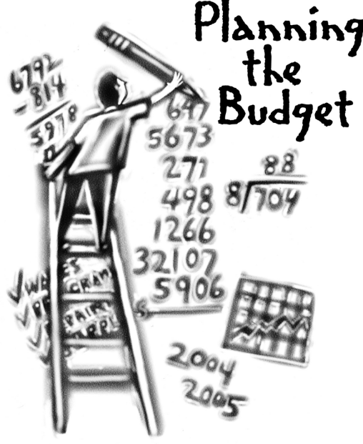
Overview of FY ‘24 GO Team Budget Process
Step 1 Review and Update Strategic Plan and Rank Strategic Priorities
By end of Fall Semester
Step 6 Principals: HR Staffing Conferences Begin
Late February – Early March
Step 3 GO Team Initial Budget Session: Allocation
January 24 – early February
Step 7 GO Team Final Budget Approval Meeting
Budgets Approved by March 17
Step 5
GO Team Feedback Session: Draft Budget Presented & Discussed
February – multiple meetings, if necessary
Step 4 Principals: Associate Supt. Discussions and Review
February (supports needed, specific challenges, coaching)
Step 2 Principals: Workshop FY 24 Budget
January 24, 2023
GO Teams are encouraged to have ongoing conversations about the school’s budget.

Slide 5
Budget Approval Meeting
What
During this meeting GO Teams will review the budget, which should be updated based on feedback from the staffing conference, Associate Superintendents, and key leaders. After review, GO Teams will need to take action (i.e., vote) on the FY24 Budget.
Why
Principals will present the final budget recommendations for GO Team approval.
When
All approval meetings must be held after staffing conferences. Budgets must be approved by March 17th.

Slide 6
Budget Review

Slide 7

FY24 Budget Parameters
FY24 School Priorities | Rationale
Maintain lower class sizes in the primary years by funding parapros in 1st and second grade | 47% mobility rate requires a great deal of teacher attention to students who enter our school throughout the year – many of which are below level.
Maximize wrap around services ie: Nurse, SSW, Counseling | This continues to be a need for our students, but we need to look closely at maximizing our budget to make this work.
Increase Reading/Lexiles and writing of 3rd – 5th grade students. How can we restructure our program to achieve this? | Data indicates that students who have been with us for more than one year have greater performance levels than students who are transient. With 47% of our students coming and going, there is a need to target these students.
Example – insert the slides from your feedback meeting
Notes:
Review the priorities that the GO Team has developed and the rationale for these priorities. Feel free to copy this slide if you have more than 3 priorities to account for.

Slide 8
Descriptions of Strategic Plan
Breakout Categories
Priorities: FY24 funding priorities from the school’s strategic plan, ranked by the order of importance.
APS Five Focus Area: What part of the APS Five is the priority aligned to?
Strategies: Lays out specific objectives for school’s improvement.
Request: “The Ask” What needs to be funded in order to support the strategy?
Amount: What is the cost associated with the Request?

Slide 9
FY24 Strategic Plan Break-out
Priorities | APS FIVE Focus Area | Strategies | Requests | Amount
Increase level of rigor and relevance (example- please remove) | Fostering Academic Excellence for All (example- please remove) | Implementation of guided reading training for all staff (example- please remove) | Purchase an additional Teacher (example- please remove) | $84, 134 (example- please remove)
EXAMPLE
Notes:
For the next few slides, I will show you how I have allocated the budget to support our strategic priorities.
Based on our strategic priorities and funds we received, here is a break-out of the priorities, which focus area it addresses, the strategies that will be implemented, the purchase request, which funding source was used and the amount.

Slide 10
FY24 Strategic Plan Break-out
Priorities | APS FIVE Focus Area | Strategies | Requests | Amount
Increase level of rigor and relevance (example- please remove) | Fostering Academic Excellence for All (example- please remove) | Implementation of guided reading training for all staff (example- please remove) | Purchase an additional Teacher (example- please remove) | $84, 134 (example- please remove)
EXAMPLE
Notes:
For the next few slides, I will show you how I have allocated the budget to support our strategic priorities.
Based on our strategic priorities and funds we received, here is a break-out of the priorities, which focus area it addresses, the strategies that will be implemented, the purchase request, which funding source was used and the amount.

Slide 11
Plan for FY24 CARES Allocation $(Insert Amount Here)___
Priorities | APS FIVE Focus Area | Strategies | Requests | Amount
Increase level of rigor and relevance (example- please remove) | Fostering Academic Excellence for All (example- please remove) | Implementation of guided reading training for all staff (example- please remove) | Purchase an additional Teacher (example- please remove) | $84, 134 (example- please remove)
EXAMPLE
Notes:
For the next few slides, I will show you how I have allocated the budget to support our strategic priorities.
Based on our strategic priorities and funds we received, here is a break-out of the priorities, which focus area it addresses, the strategies that will be implemented, the purchase request, which funding source was used and the amount.

Slide 12
Plan for FY24 Title I Family Engagement Funds
$___(Insert Amount Here)___
Priorities | APS FIVE Focus Area | Strategies | Requests | Amount
Increase level of rigor and relevance (example- please remove) | Fostering Academic Excellence for All (example- please remove) | Implementation of guided reading training for all staff (example- please remove) | Purchase an additional Teacher (example- please remove) | $84, 134 (example- please remove)
EXAMPLE
Notes:
For the next few slides, I will show you how I have allocated the budget to support our strategic priorities.
Based on our strategic priorities and funds we received, here is a break-out of the priorities, which focus area it addresses, the strategies that will be implemented, the purchase request, which funding source was used and the amount.

Slide 13

Staffing Conference Changes
Principals –indicate on this slide if there were any changes made to your budget proposal at your staffing conference. If there were no changes, please just cover the Budget by Function on slides 7 & 8 as a quick summary for your GO Team. If there were changes, please summarize for your team and then discuss the NEW Budget by Function values.
There were/were not any changes made to the draft budget we discussed at our last meeting.
These changes reflect an allocation change of +/- $xxxx.xx.

Slide 14
Summary of Changes
Change at Staffing Conference | Impact to Proposed Budget

Slide 15
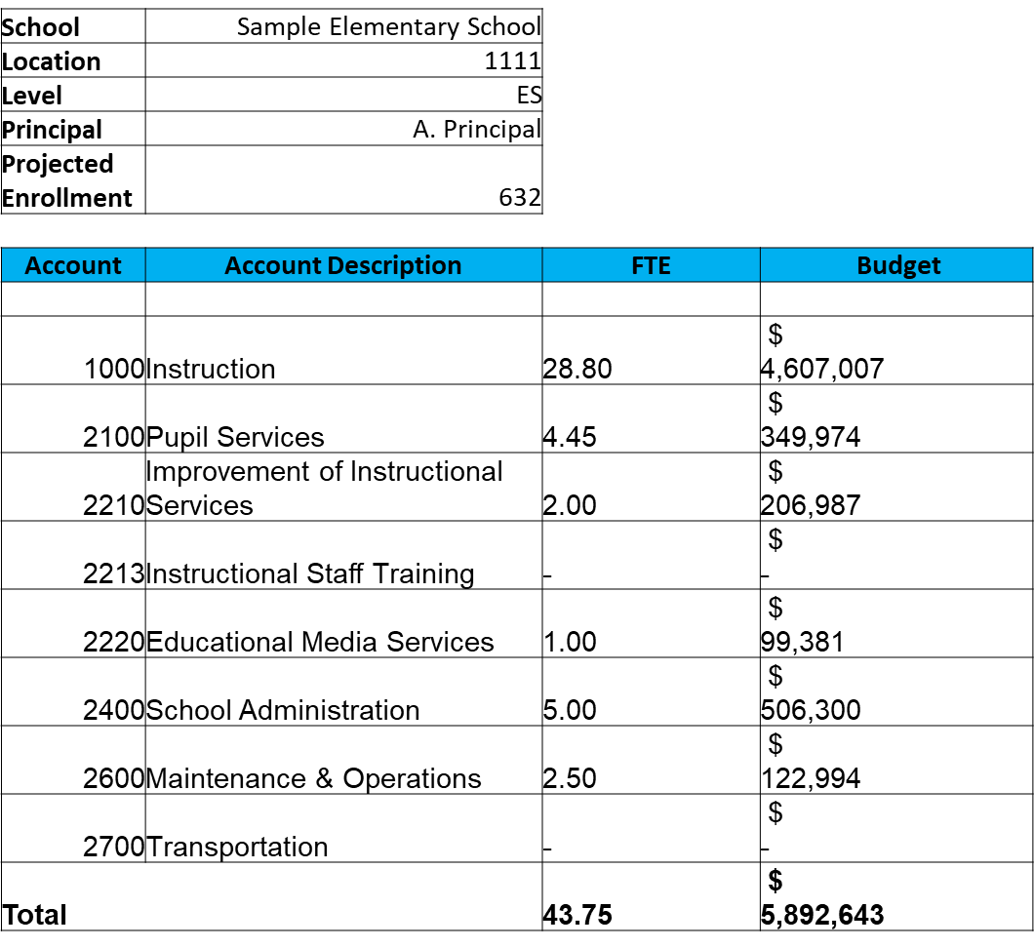
Budget by Function (Required)
*Based on Current Allocation of School Budget
Example

Slide 16
Budget by Function (Required)
*Based on Current Allocation of School Budget
Example

Slide 17
Discussion of reserve and Holdback funds

Slide 18
Plan for FY24 Leveling Reserve
$__(Insert Amount Here)___
Priorities | APS FIVE Focus Area | Strategies | Requests | Amount
Increase level of rigor and relevance (example- please remove) | Fostering Academic Excellence for All (example- please remove) | Implementation of guided reading training for all staff (example- please remove) | Purchase an additional Teacher (example- please remove) | $84, 134 (example- please remove)
EXAMPLE
Notes:
For the next few slides, I will show you how I have allocated the budget to support our strategic priorities.
Based on our strategic priorities and funds we received, here is a break-out of the priorities, which focus area it addresses, the strategies that will be implemented, the purchase request, which funding source was used and the amount.

Slide 19
Plan for FY24 Title I Holdback $___(Insert Amount Here)___
Priorities | APS FIVE Focus Area | Strategies | Requests | Amount
Increase level of rigor and relevance (example- please remove) | Fostering Academic Excellence for All (example- please remove) | Implementation of guided reading training for all staff (example- please remove) | Purchase an additional Teacher (example- please remove) | $84, 134 (example- please remove)
EXAMPLE
Notes:
For the next few slides, I will show you how I have allocated the budget to support our strategic priorities.
Based on our strategic priorities and funds we received, here is a break-out of the priorities, which focus area it addresses, the strategies that will be implemented, the purchase request, which funding source was used and the amount.

Slide 20
Questions for the GO Team to Consider and Discuss
Are our school’s priorities (from your strategic plan) reflected in this budget?
Are new positions and/or resources included in the budget to address our major priorities?
Do we know (as a team) the plan to support implementation of these priorities beyond the budget (ex. What strategies will be implemented)?
What tradeoffs are being made in order to support these priorities?
How are district and cluster priorities reflected in our budget?
Cluster priorities- what staff, materials, etc. are dedicated to supporting our cluster’s priorities?
Signature programs- what staff, materials, etc. are dedicated to supporting our signature program?
Are there positions our school will share with another school, e.g. nurse, counselor?
Notes:
CHAIR - Our final task for today! Here are questions that we need to consider to ensure we have a good working draft budget. Let’s walk through them together.

Slide 21

Questions?

Slide 22
The GO Team needs to TAKE ACTION (vote) on the presented budget. After the motion and a second, the GO Team may have additional discussion. Once discussion is concluded, the GO Team will vote.
Action on the Budget

Slide 23

BASC-3 Data

Slide 24
Insert BASC-3 data if available – use as many slides as necessary

Slide 25

2023 Spring ACES
NOTE to Principal: Please insert your Spring ACES presentation after this slide.
Accountability
Collaboration
Equity
Support

Slide 27
Questions?

Slide 28

Thank you

